Slide 1
Handbook of Functional Physiologic Assays (suitable for organoids, cell culture and model systems)
RBK2 Functional Assay Working Group
9/20/2021

Slide 2
Working group members who contributed to this Handbook:
Catherine Baty (Pitt)
Joe Bonventre (Harvard)
Rolando Carrisoza-Gaytan (ISMMS)
Mark de Caesteker (Vanderbilt)
Beno Freedman (Washington)
Basil Hanss (ISMMS)
Tom Kleyman (Pitt)
Luke Lee (Harvard)
Ryuji Morizane (Harvard)
Lisa Satlin (ISMMS)

Slide 3
Table of physiologic assays: glomerular function
target function | method |  | reference
Glomerular filtration rate
 | Transdermal measurement of glomerular filtration rate in mice |  | https://www.jove.com/t/58520/transdermal-measurement-of-glomerular-filtration-rate-in-mice
 | Transcutaneous measurement of GFR using FITC-sinistrin in rats |  | Schock-Kusch et al., Nephrol Dial Transplant 24: 2997–3001, 2009
Glomerular sieving/selectivity
 | In Vivo Assessment of Size-Selective Glomerular Sieving in Transplanted Human Induced Pluripotent Stem Cell–Derived Kidney Organoids |  | van den Berg, CW, et al. JASN 31: 921–929, 2020

Slide 4
Table of physiologic assays: tubular function
target process | target segment | critical reagent | assay | reference
organic anion transport | PT
 |  | phenol red | segment ID
 |  | phenol red | luminal fluid acidification
 |  | 6-carboxyfluorescein (6CF) | OAT
 |  | methotrexate | OAT1 & 3 (drug taken up by basolateral OAT1 and OAT3 and, is then eliminated into urine via apical MRP2 and MRP4 transporters) | Freedman BS et al. Nat Commun. 2015 Oct 23;6:8715. doi: 10.1038/ncomms9715.
organic cation transport | PT
 |  | ethidium bromide (EtBr) | OCT1,2,3
Ca²⁺ transport |  | Fura 2-AM | Measurement of [Ca²⁺]i
H⁺ transport | PT, CD | see phenol red above

Slide 5
Table of physiologic assays: absorption
target process | target segment | critical reagent | assay | reference
Na⁺ transport | PT, TALH, DCT,CD
 |  | fluorescent probes
 |  |  | Na⁺-K⁺-ATPase
 |  |  | Na⁺/H⁺ exchange | Liu et al. Am. J. Physiol. Renal 2012. https://doi.org/10.1152/ajprenal.00179.2011
water | CD | forskolin-induced water transport | CFTR-dependent organoid swelling in response to forskolin | doi: 10.1038/nm.3201 doi: 10.3791/5515

Slide 6
Assays for Glomerular Function
Assays for glomerular filtration rate (GFR)
Several different approaches available:
Inulin clearance - gold standard
Radionuclides
Imaging techniques (CT, MRI, etc)
Pharmacokinetics (i.e. plasma clearance of exogenous tracers, e.g., FITC-conjugated sinistrin )
Assays for glomerular sieving function
Track fluorophore-tagged molecules of increasing size through the kidney

Slide 7
Transdermal measurement of glomerular filtration rate in mice
Assays for GFR
Scarfe L., Schock-Kusch D, Ressel L., Friedemann J., Shulhevich Y., Murray P., Wil B., de Caestecker M. https://www.jove.com/t/58520/transdermal-measurement-of-glomerular-filtration-rate-in-mice
Abstract
Transdermal analysis of glomerular filtration rate (GFR) is an established technique that is used to assess renal function in mouse and rat models of acute kidney injury and chronic kidney disease. The measurement system consists of a miniaturized fluorescence detector that is directly attached to the skin on the back of conscious, freely moving animals, and measures the excretion kinetics of the exogenous GFR tracer, fluorescein-isothiocyanate (FITC) conjugated sinistrin (an inulin analog). This system has been described in detail in rats. However, because of their smaller size, measurement of transcutaneous GFR in mice presents additional technical challenges. In this paper we therefore provide the first detailed practical guide to the use of transdermal GFR monitors in mice based on the combined experience of three different investigators who have been performing this assay in mice over a number of years.

Slide 8
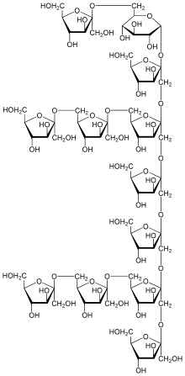
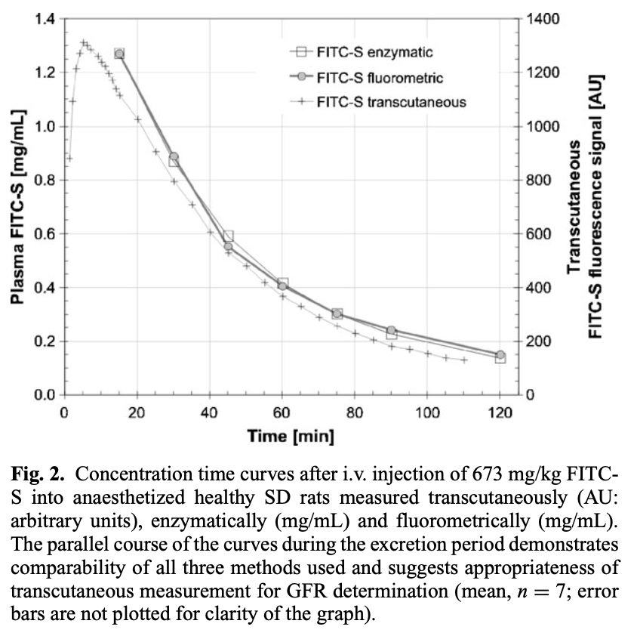
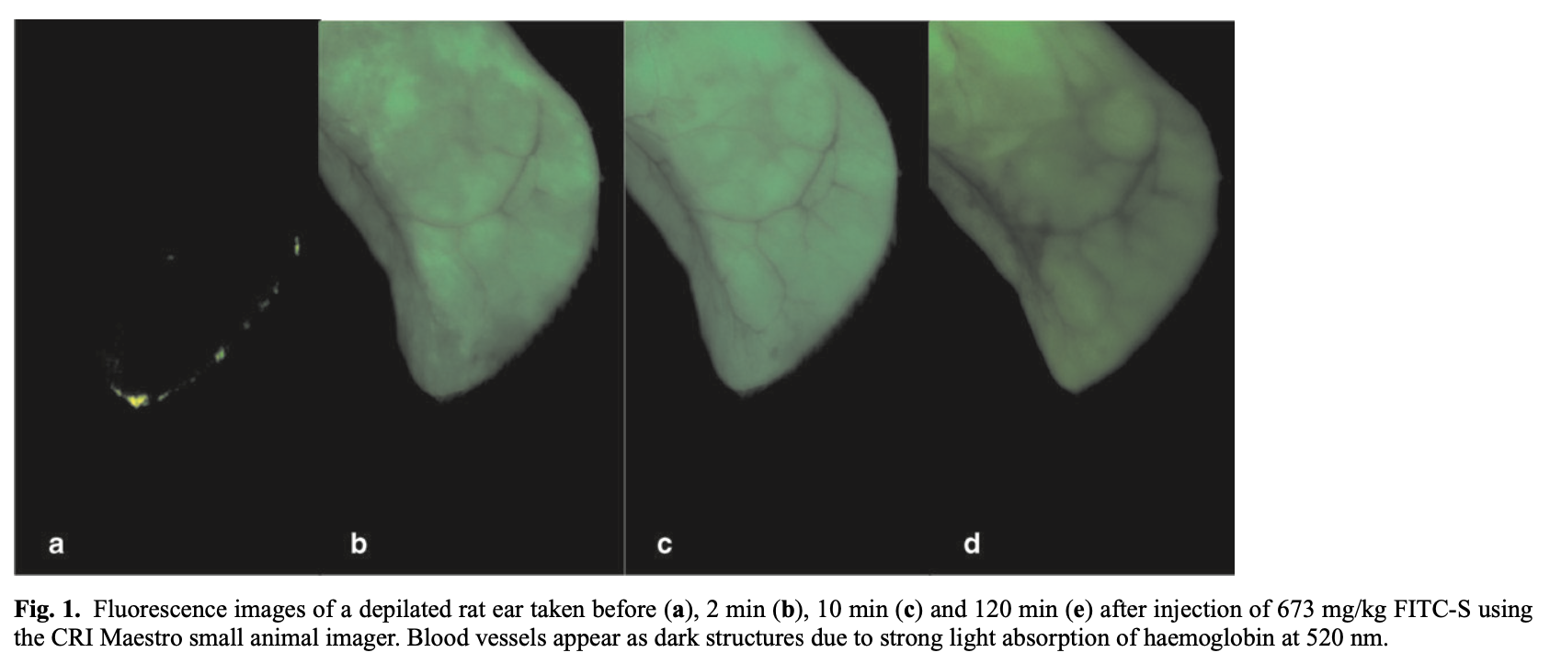
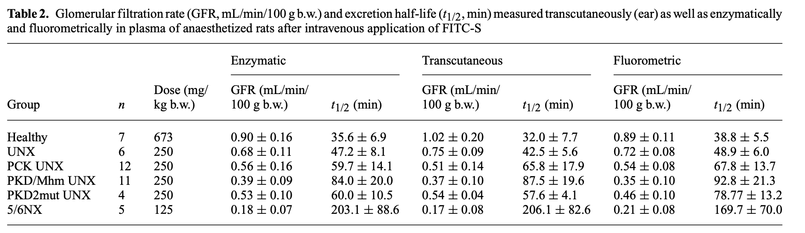
Assays for GFR
Transcutaneous measurement of GFR using FITC-sinistrin in rats
(Schock-Kusch et al., Nephrol Dial Transplant 24: 2997–3001, 2009)
sinistrin
(aka, polyfructosan and Inutest)

Slide 9
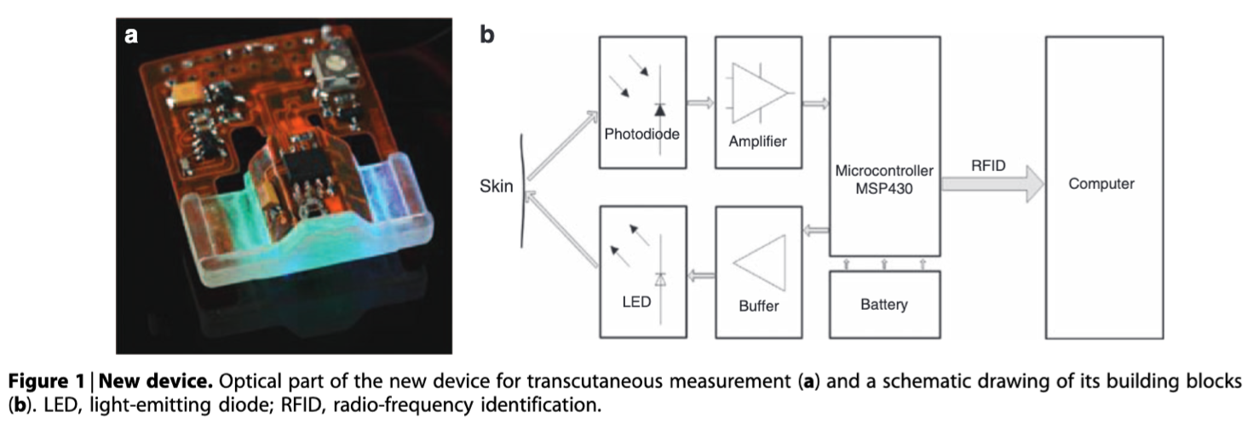
Assays for GFR
Transcutaneous assessment of renal function in conscious rats with a device for measuring FITC-sinistrin disappearance curves (Schock-Kusch et al., Kidney International 79: 1254–1258, 2011).

Slide 10
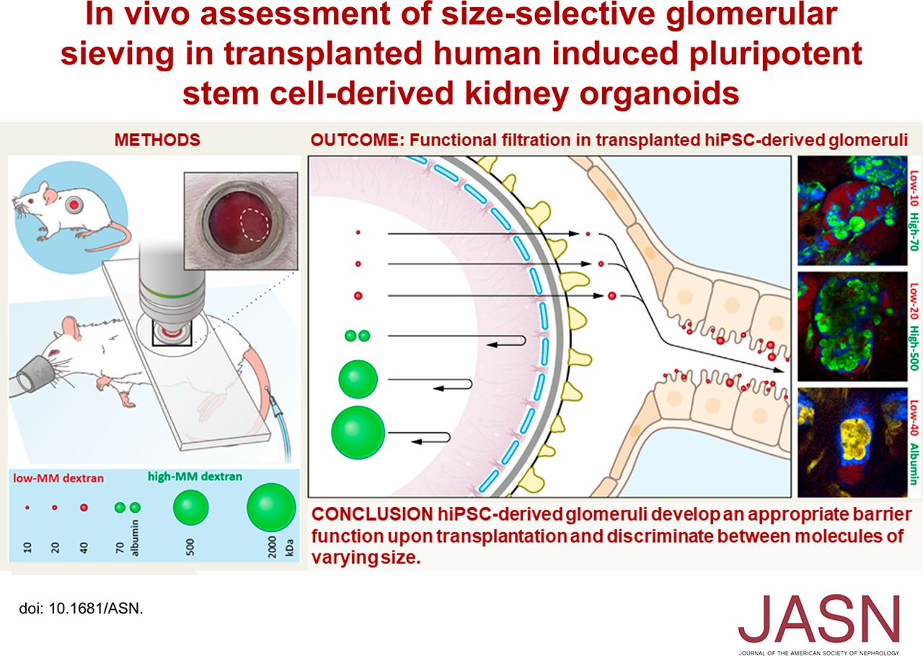
(van den Berg, CW, et al. In Vivo Assessment of Size-Selective Glomerular Sieving in Transplanted Human Induced Pluripotent Stem Cell–Derived Kidney Organoids. JASN 31: 921–929, 2020)
Notes:
Intravital microscopy -

Slide 11
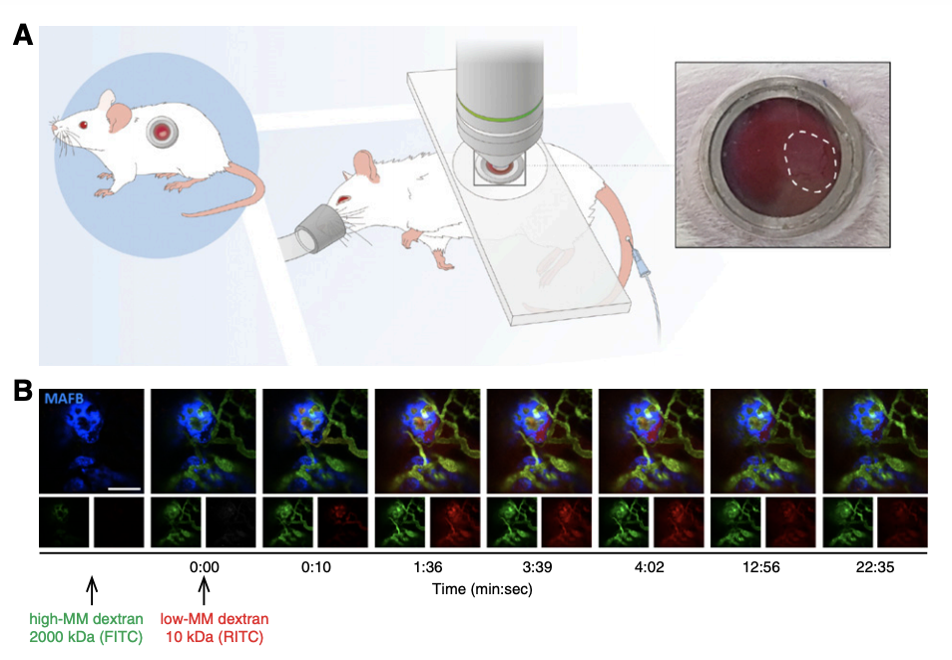
Assays for glomerular sieving function
(van den Berg, CW, et al. In Vivo Assessment of Size-Selective Glomerular Sieving in Transplanted Human Induced Pluripotent Stem Cell–Derived Kidney Organoids. JASN 31: 921–929, 2020)

Slide 12
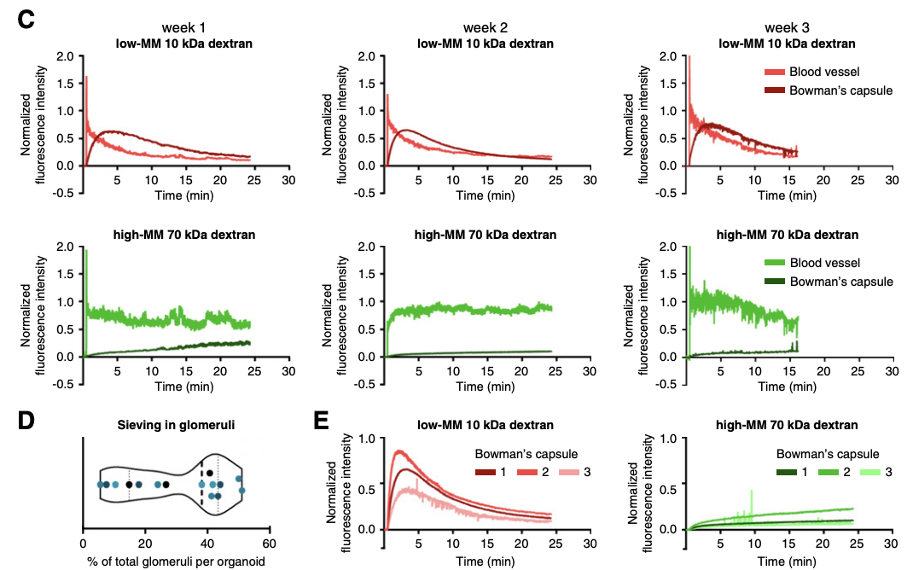
Assays for glomerular sieving function
(van den Berg, CW, et al. In Vivo Assessment of Size-Selective Glomerular Sieving in Transplanted Human Induced Pluripotent Stem Cell–Derived Kidney Organoids. JASN 31: 921–929, 2020)

Slide 13
Basic tubular functional assays

Slide 14
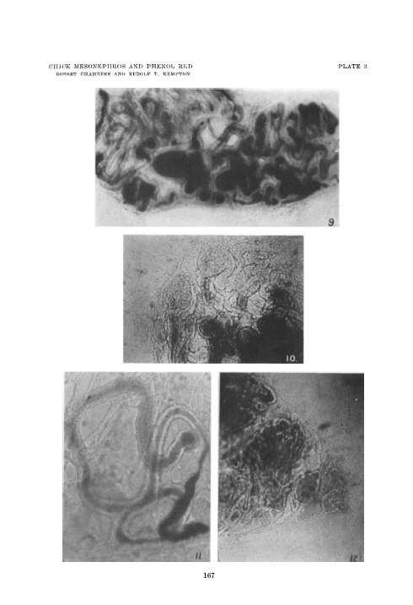
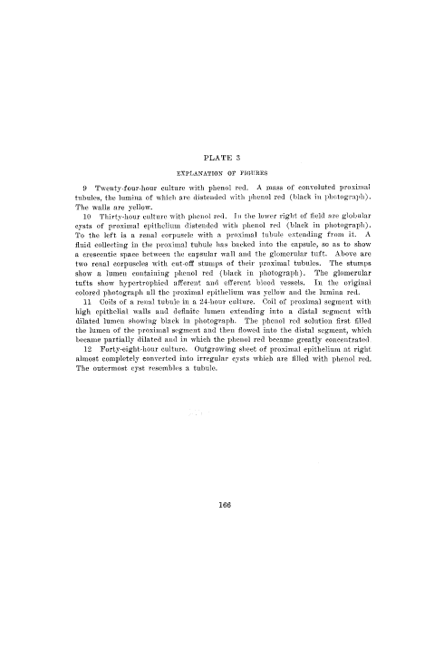
Secretion (and segment ID)
Proximal but not distal tubules isolated from meso- and metanephric kidneys from chick embryos secrete phenol red (and become distended).
Proximal tubules isolated from human metanephric kidney (3.5 mo) and cultured in aqueous solution of phenol red (final concentration of 0.025%) show distention with accumulation of phenol red as a yellow liquid in their lumina, increasing in intensity (but still yellow, and thus acid) by 48 hr
(Cameron G and Chambers R. Direct evidence of function in kidney of an early human fetus. AJP 123: 482-485, 1938).
(Chambers R and Kempton RT. Indications of function of the chick mesonephros in tissue culture with phenol red. J Cell Comp Physiol 3:131-167, 1933)

Slide 15

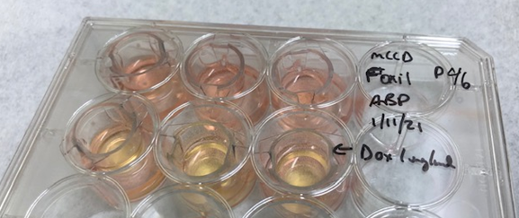
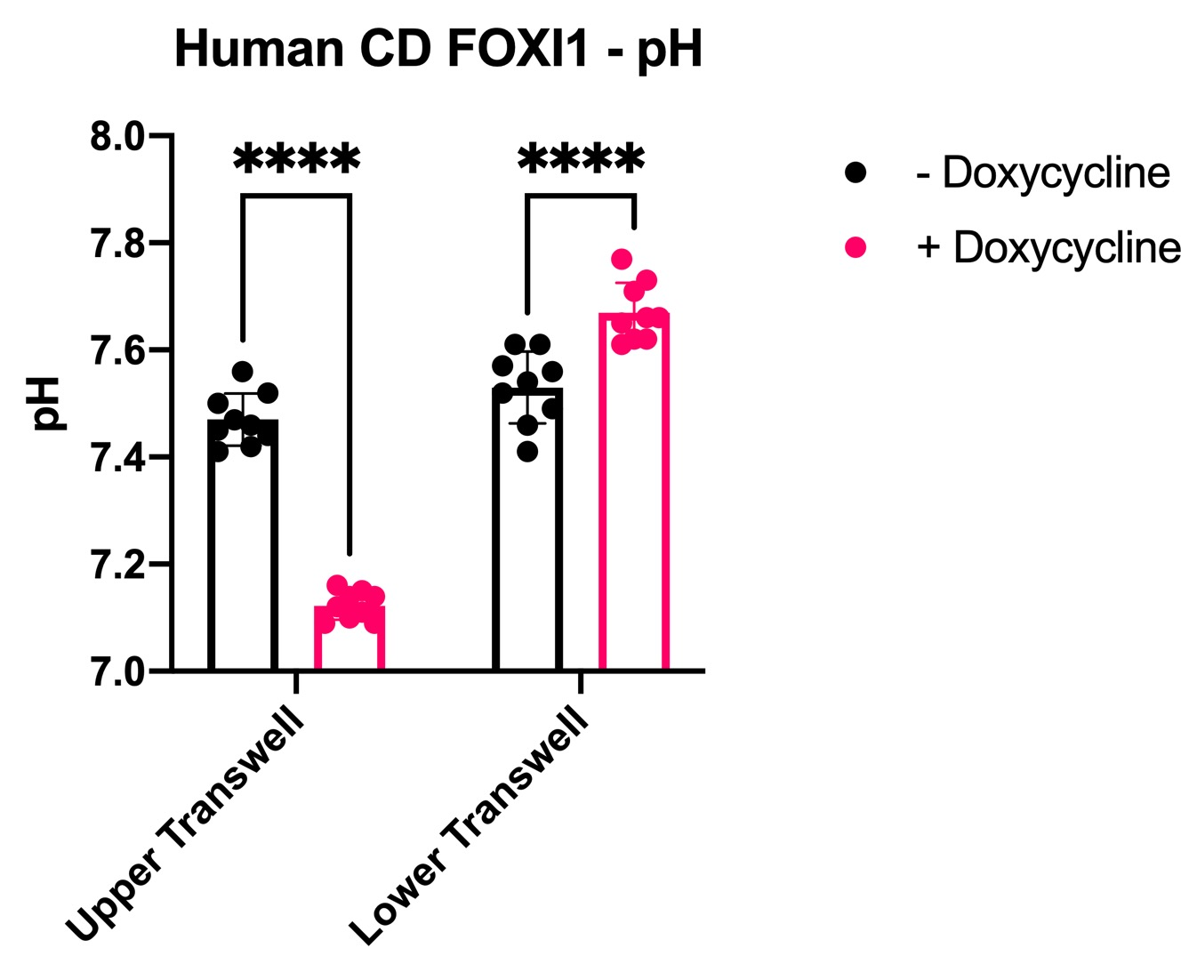
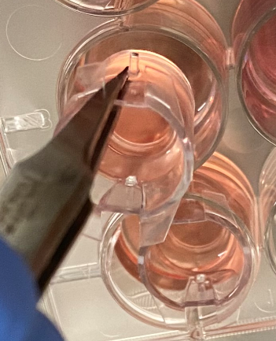
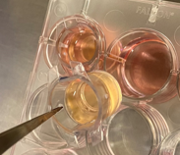
Assays for H⁺ transport
Human stem cell derived inducible intercalated cells generate a transepithelial pH gradient:
pH indicator: phenol red in the cell culture medium
pH determined using pH electrodes
Mouse
- Doxycyline
+ Doxycyline
Lower well
Lower well
Human
Upper well
Upper well
Bonventre and Lee, Harvard

Slide 16
Organoids accumulate methotrexate
Technology needed:
Segments expected to demonstrate activity:
Validated in: cell culture, organoids, zebrafish, in vitro – isolated tubules, in vivo animal models (with references)
Methods (specific for assay and quantitation) – as an RBK protocol?
Results – published (with hyperlinks) or unpublished
- interpreted in terms of results expected based on studies of (age- and sex-matched) controls
100 µm

Slide 17
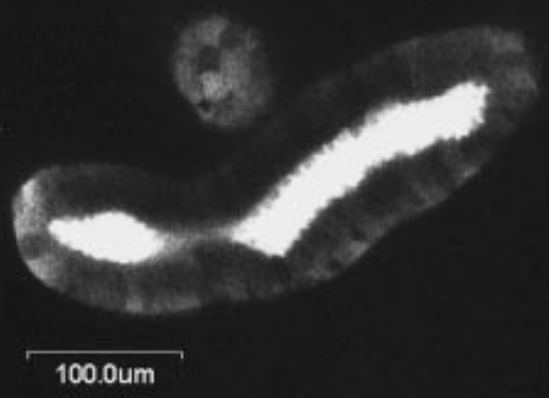
Organoids accumulate methotrexate
fluorescein
methotrexate (MTX) –
a 979 Da organic anion
Killifish proximal tubule pulsed with MTX (Masereeuw et al., Mol. Pharm., 1999)
100 µm
During chase, MTX exits tubules faster than RD
Freedman et al., Nat. Comms., 2015

Slide 18
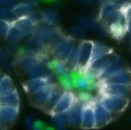
Secretion assay in kidney organoids: methotrexate
0.5h
1h
4h
Methylene Blue
MTX: FITC-methotrexate
Methylene Blue: Organoids were incubated with 3 ul of 1.5% methylene blue (Sigma Aldrich) in 200 ul Advanced RPMI media (Thermo Fisher) x 30 min, 1 hr, and 4 hrs, and washed with PBS twice. The organoids were embedded in OCT compound (Fisher Scientific) and frozen with liquid nitrogen. Cryosections of organoids were prepared with a Leica cryostat. Sections were imaged by light microscopy.
FITC-labeled Methotrexate:
Organoids were incubated with 10 uM FITC-labeled methotrexate (Thermo Fisher) in 200 ul Advanced RPMI media (Thermo Fisher) x 4 hrs and washed with Advanced RPMI three times. Organoids were fixed with 4% paraformaldehyde (Electron Microscopy Sciences) at room temperature for 1 hr. Organoids were embedded in OCT compound (Fisher Scientific) and frozen with liquid nitrogen. Cryosections sections were immunostained with antibodies.
Bonventre, Harvard

Slide 19
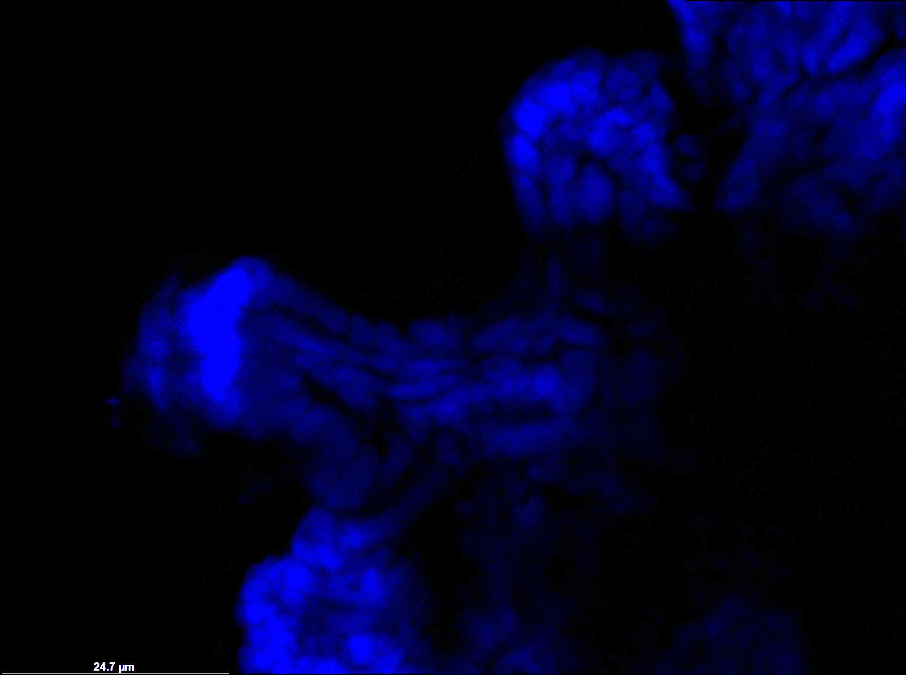

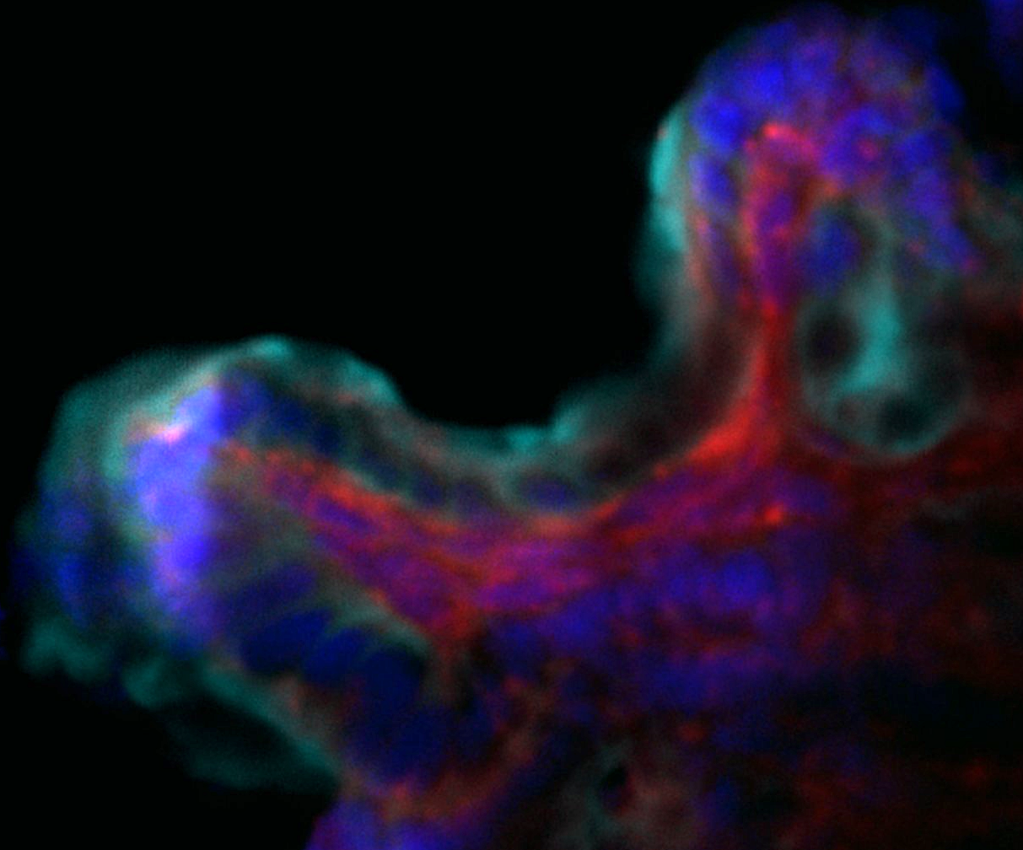
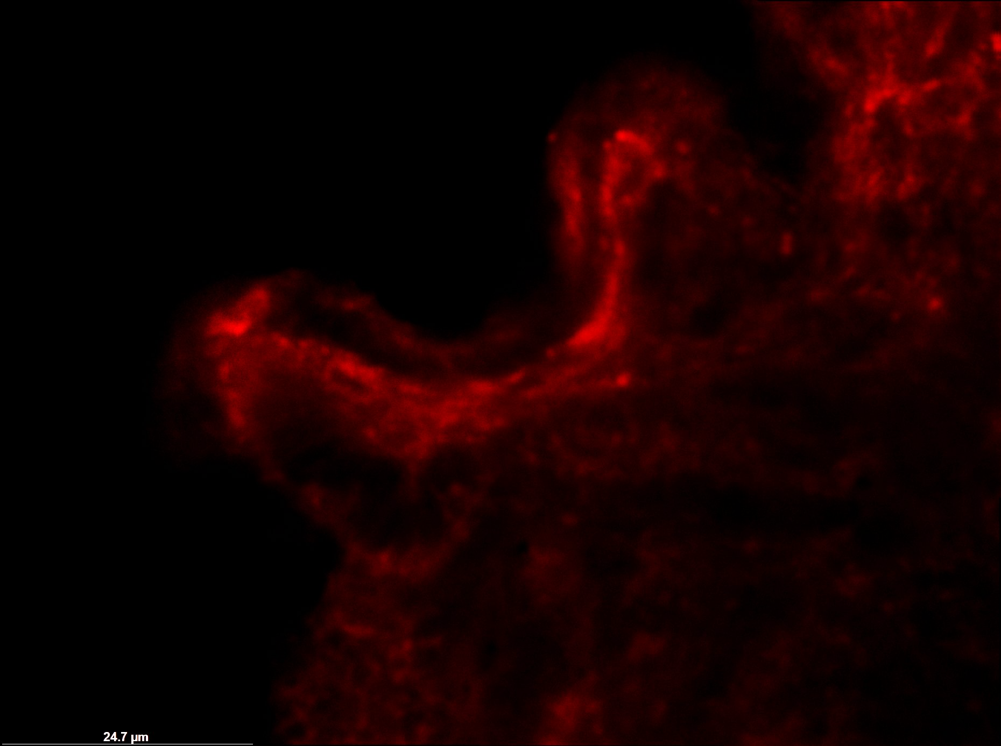
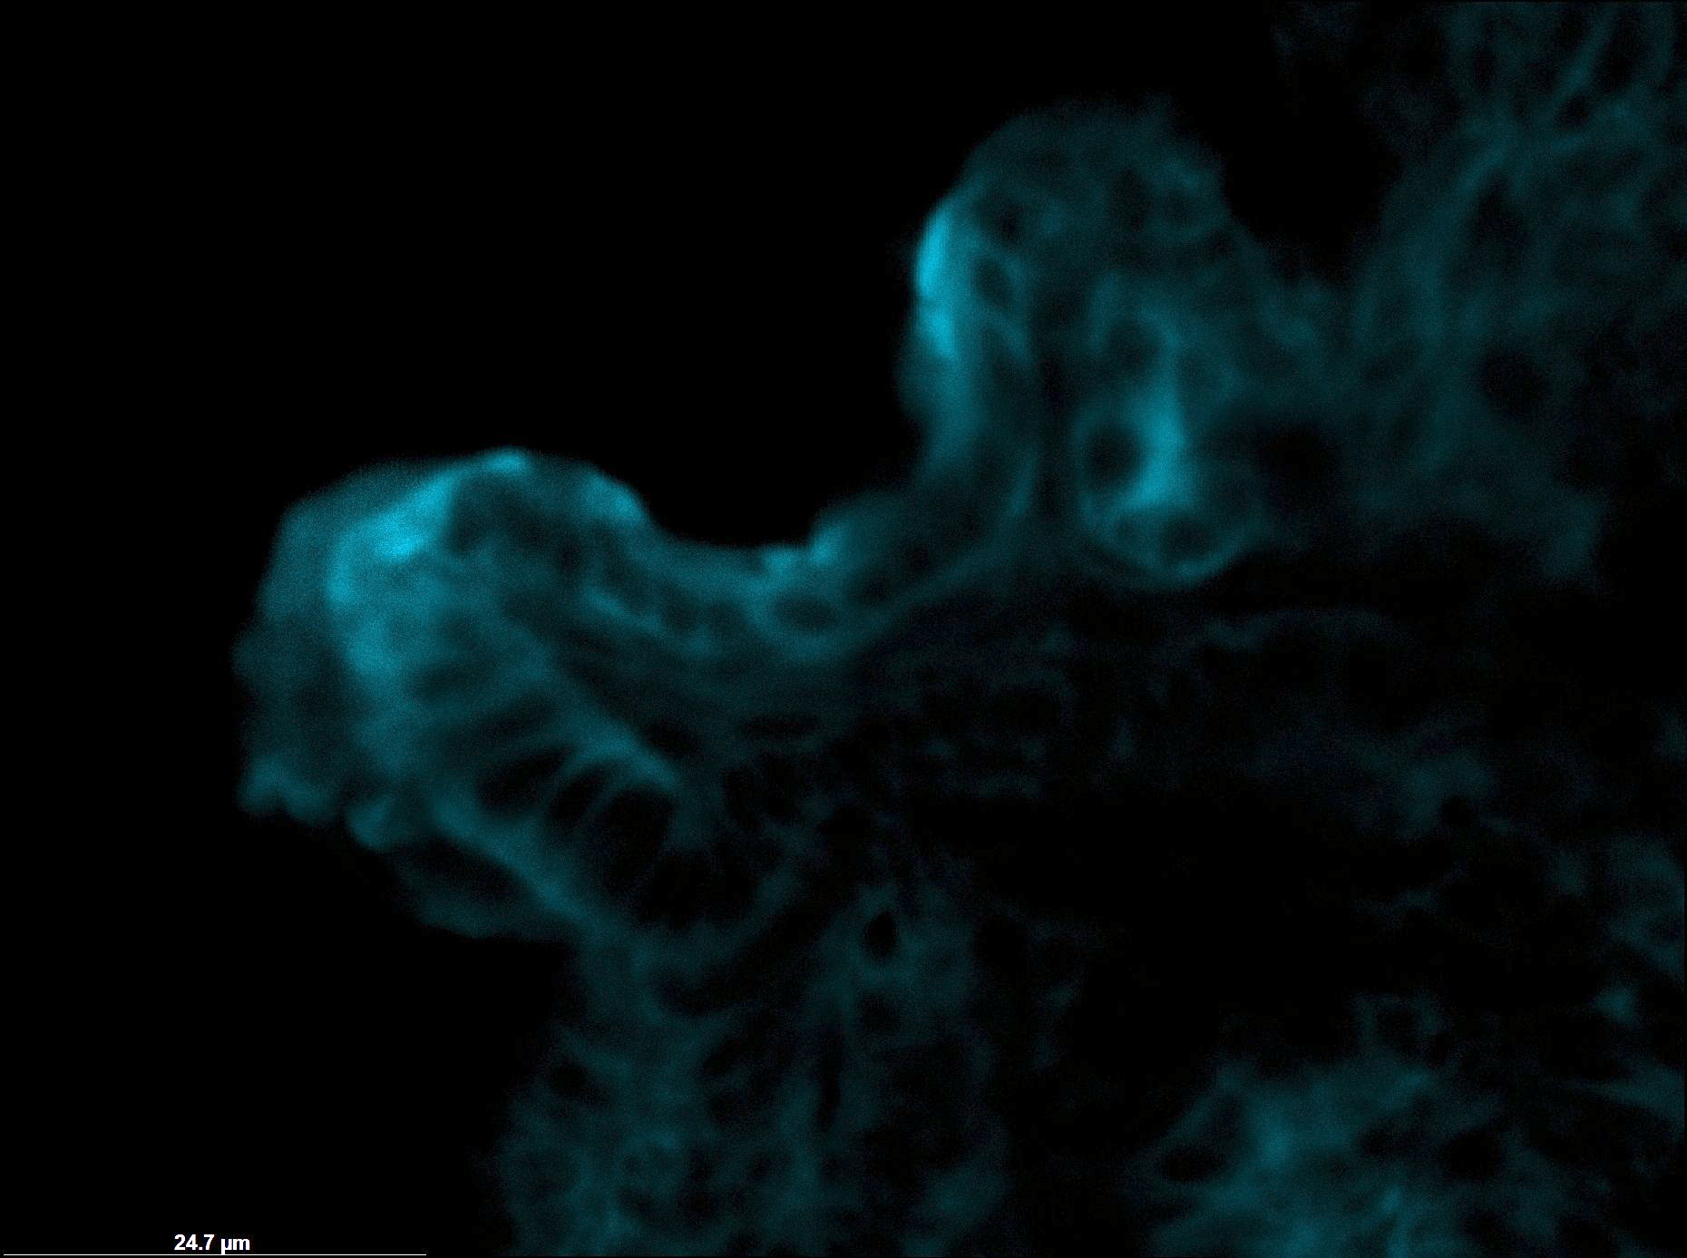
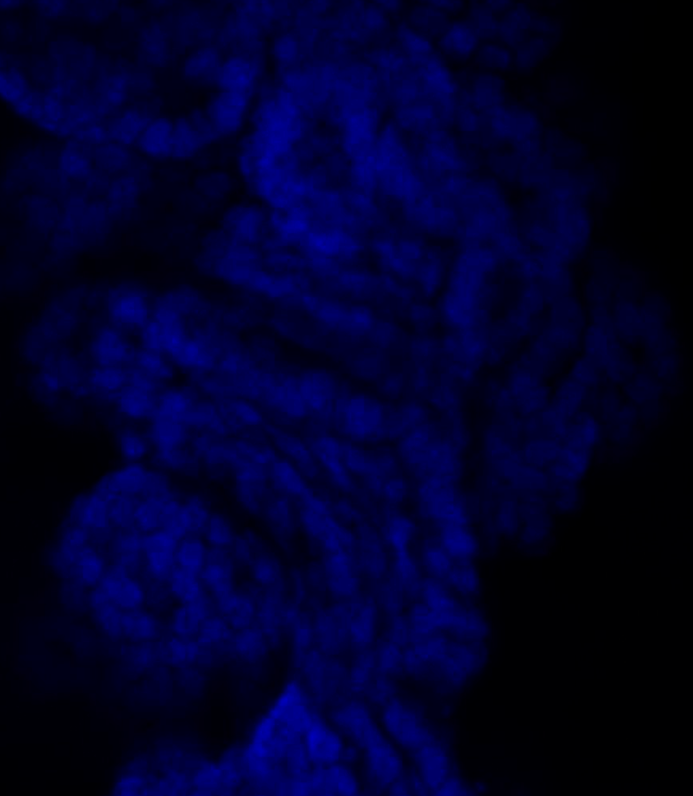
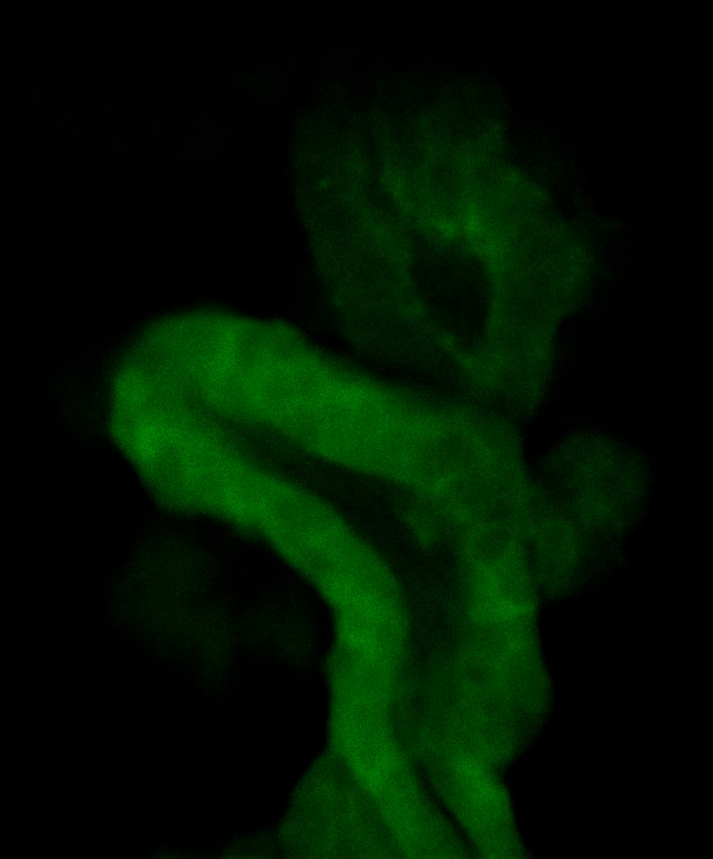
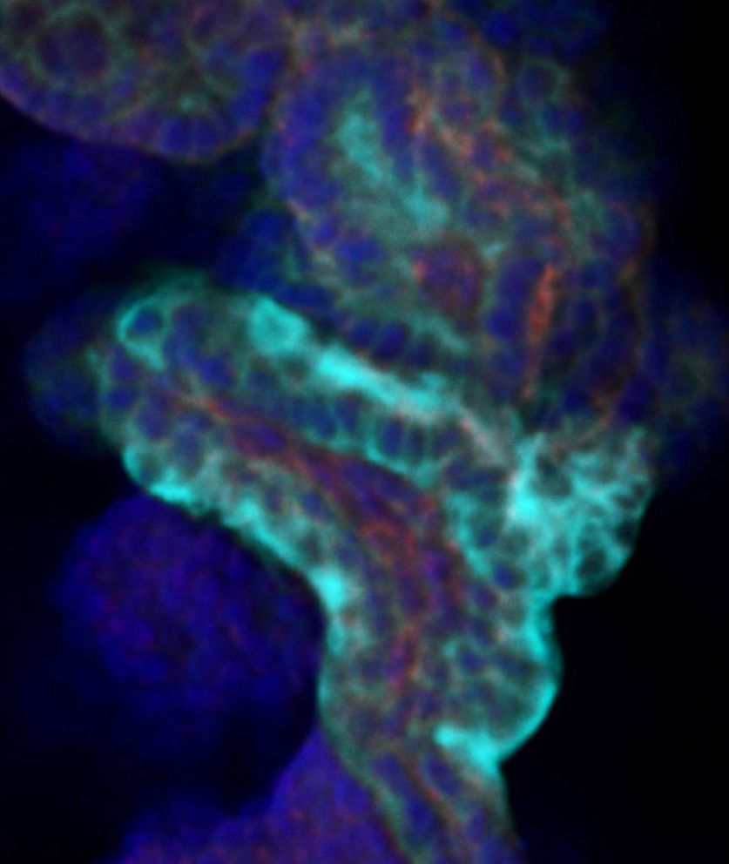
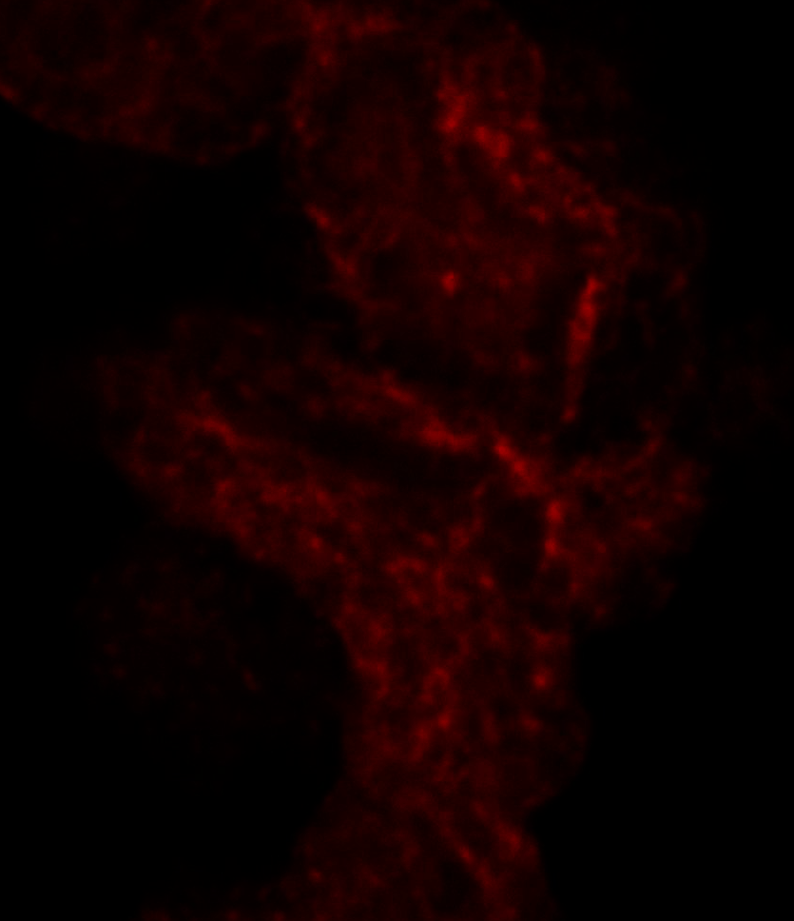
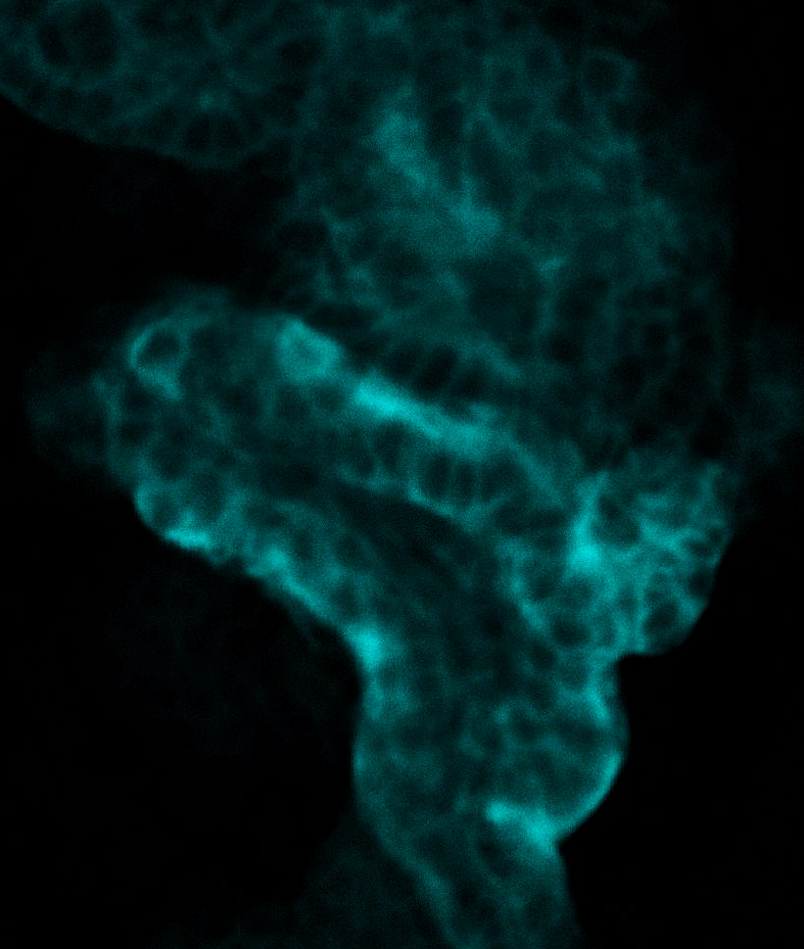
MDR1-mediated efflux into tubular lumen
in kidney organoids
LIVE Imaging of Rhodamine 123
FIX STAINING Rhodamine 123
Rhodamine123(+) PSC-833 (-) Day 26
DAPI
Rho123
DAPI Rho123 MDR1 LTL
MDR1
LTL
Rhodamine123 is secreted into the tubular lumen via MDR1. Live imaging of organoids treated with Rhodamine123 shows luminal accumulation. An inhibitor of MDR1 enhanced cytoplasmic accumulation of Rhodamine123 potentially by inhibiting MDR1-mediated efflux.
Rhodamine123(+) PSC-833 (+) Day 26
DAPI
Rho123
DAPI Rho123 MDR1 LTL
MDR1
LTL
Morizane

Slide 20
MDR1-mediated efflux into tubular lumen
in kidney organoids
Live staining: Rho123
Wash organoid with RPMI phenol red-free medium 3X
Incubate live organoid with LTL-live staining (1:500) and 10 µM Rho123
Incubate for 3h, 37ºC, orbital shaker 200 rpm
Wash with RPMI phenol red free 3X before imaging
Live staining: Rho123 inhibition
Wash organoid with RPMI phenol red-free medium 3X
Incubate live organoid with 5 µM PSC-833, 1 h, 37ºC, orbital shaker 200 rpm
Wash with RPMI phenol red-free 3X
Proceed with steps above for Live staining: Rho123
Notes:
The incubation time can be modified based on the organoid size.
For fix staining, fix organoids with PFA 4% and continue IF staining.
Morizane

Slide 21
Organic anion and cation transporters
OAT
6-carboxyfluorescein (6CF) as prototypic organic anion to test OAT function in vivo (Lawrence et al, Scientific Reports 5: 9092,2015).
6CF uptake is inhibited by probenecid.
OCT
OCT1,2,3 mediate transport of ethidium bromide (EtBr) in PT (Lee et al. AJP Renal 296:F1504-13, 2009).
EtBr uptake is inhibited by cimetidine.
Kleyman, Pittsburgh

Slide 22
Organic anion and cation transporters:
combined OAT and OCT assay
Fluorescent Probes
6-carboxyfluorescein (6CF)
C 1360, Invitrogen, stored at 4ºC in dessicator.
Make fresh 10 mM stock of 6CF in optiMEM I.
Place at least 15 organoids in final concentration 1 µM 6CF in optiMEM; shake gently at 37ºC for 35 min. Then add EB to same group.
Ethidium bromide (EB)
BP-102, FisherBiotech.
Final concentration 10 µM.
Add in high concentration (100x), so negligible dilution of 6CF for last 10 min of incubation (shake, 37ºC). Rinse 3x and image as soon as possible.
Live confocal microscopy
Conventional settings used for 488 nm and 552nm lasers, but use sequential scanning to avoid bleed thru and bidirectional scanning to speed image collection.
Need to optimize for confocal system but we use 25x H2O objective, 4% 552 laser and 6% 488 laser.
Kleyman, Pittsburgh

Slide 23
Organic anion and cation transporters: combined OAT and OCT assay
6CF
EB
6CF for OA transport
EB for OC transport
Arrows point to same tubules. Note both basolateral uptake and luminal
secretion of 6CF (OAT), but no apparent luminal secretion of EtBr/OCT transport.
Kleyman, Pittsburgh

Slide 24
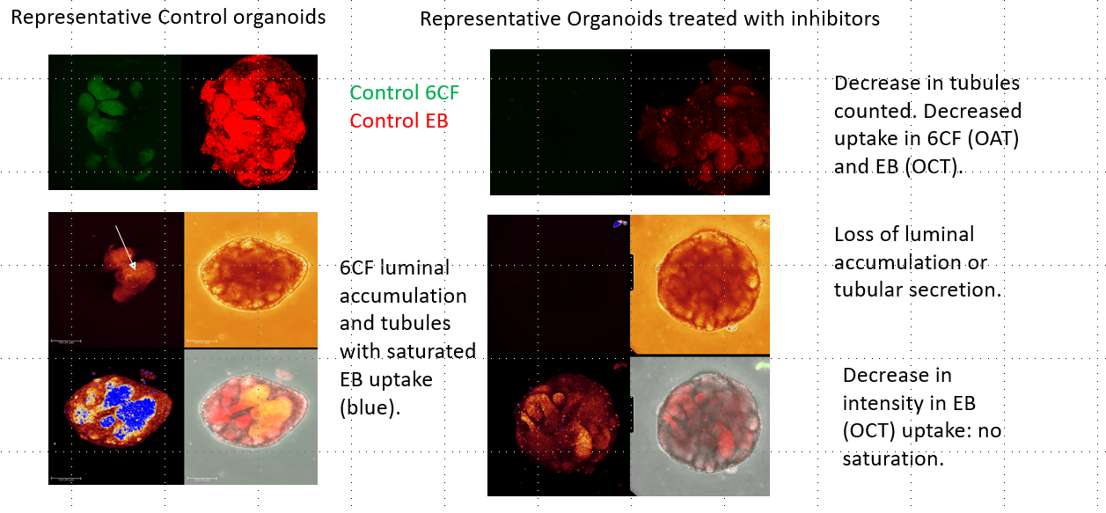
Organic anion and cation transporters:
combined OAT and OCT assay
Semiquantitative approach:
Score blinded for treatment.
Using maximum projection images, score for gross number of tubules at top and midsection, saturation for gross intensity, and any luminal accumulation.
Compare with control sets, at least 10 well or moderately developed organoids per group.
Kleyman, Pittsburgh

Slide 25
Assays for Na⁺ transport
Fluorescent probes:
Use cell-permeant acetoxymethyl esters to load cells with dyes
CoroNa™ Green (CoroNa)
Life Technologies (Cat. No. C36676)
Asante NaTRIUM Green-2 (ANG-2)
TEFLabs (Cat. No. 3512)
Dyes reconstituted in DMSO and diluted in HBSS containing 0.02% of Pluronic® F127 to the final concentrations of 10 µM for CoroNa and 5 µM for ANG-2.
Fluorescence microscopy
excitation filter: 482 nm
emission filter: 536 nm

Slide 26
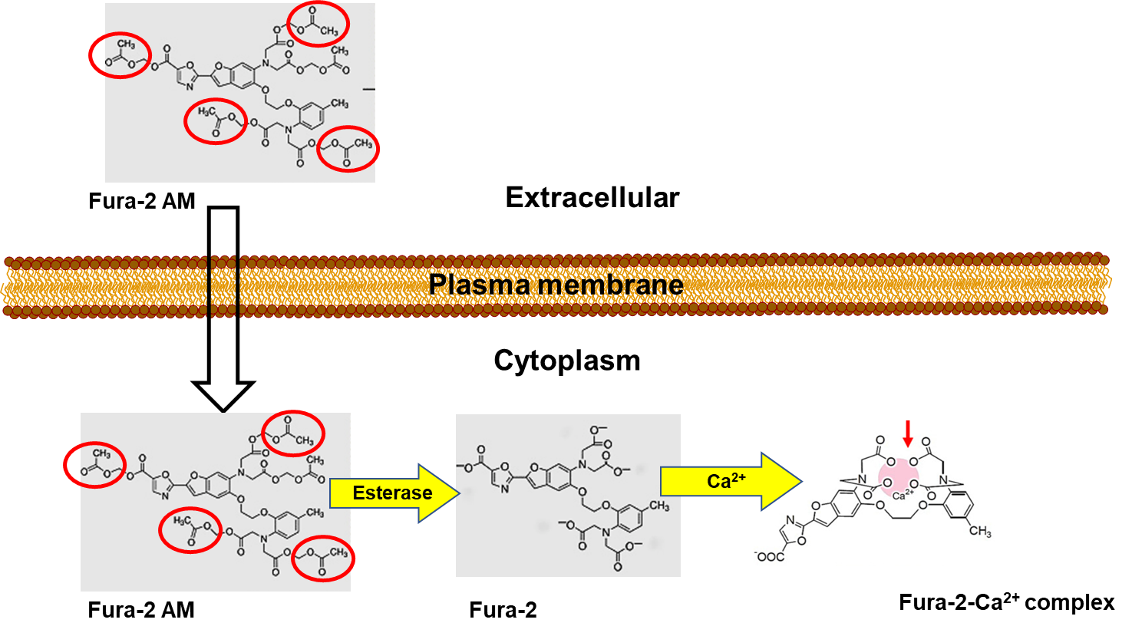
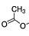
Use of -AM conjugated fluorescent functional dyes*
to detect intracellular changes in [Na⁺, H⁺, Ca²⁺]
(CoroNa™ Green-AM,
BECECF-AM, and
Fura 2-AM, respectively)
+ 4
Selective accumulation of AM dyes requires esterase activity – in intercalated cells, dyes accumulation is prevented by preincubation with the carbonic anhydrase (CA) inhibitor acetazolamide
(Satlin LM and Schwartz GJ. Postnatal maturation of rabbit renal collecting duct: intercalated cell function. Am. J. Physiol. Renal 253: F622-F635,1987)

Slide 27
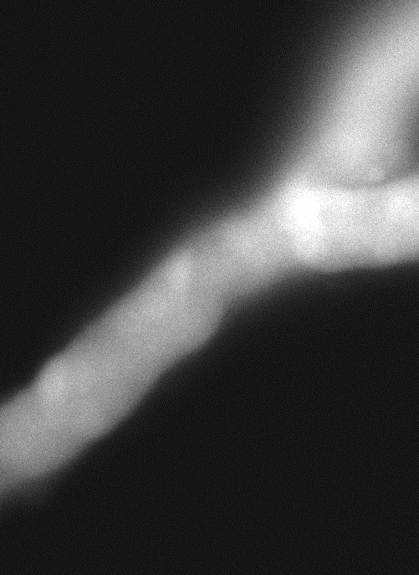
Measurement of intracellular Na⁺ concentration ([Na⁺]i) and Na⁺-K⁺-ATPase activity using CoroNa Green
Microdissected tubule:
transferred to a specimen chamber assembled with a No. 1 coverslip painted with 2 µL poly-D-lysine hydrobromide (0.01%) and set on the stage of an inverted epifluorescence microscope.
positioned on the poly-D-lysine to immobilize the segment for the duration of the experiment.
bathed in solution continuously exchanged at a rate of 10 ml/h using a syringe pump.
After 45 min equilibration at 37ºC:
tubule loaded with 10 µM CoroNa Green AM added to the bath x 30 min and rinsed x 10 min.
Fluorescent imaging:
tubule excited at 490 nm and images of the fluorescence emission at 530 nm acquired at intervals ranging from 30-60 s using MetaFluor image acquisition software (Universal Imaging, West Chester, PA).
after stable baseline fluorescence intensity achieved, ouabain (2 mM) added to the bath x 30 min to inhibit Na⁺/K⁺-ATPase and then washed out.
Fluorescence intensity of images analyzed using MetaFluor.
Branched mouse CCD loaded
with CoroNa Green

Slide 28
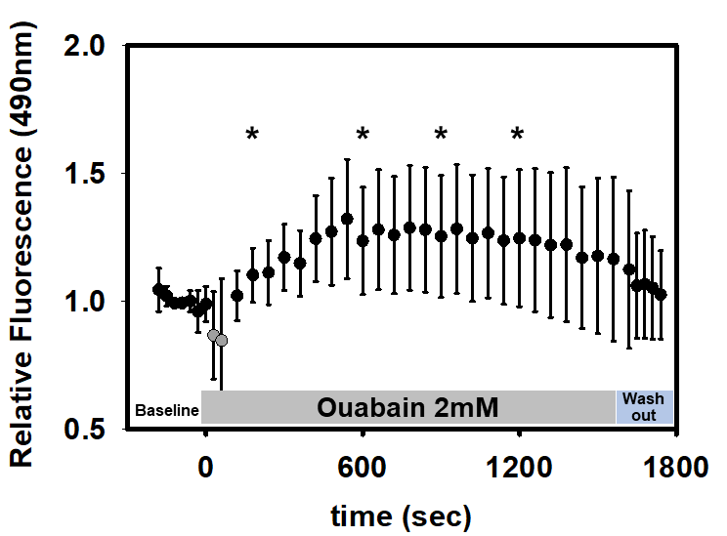
Measurement of intracellular Na⁺ concentration ([Na⁺]i)
and Na⁺-K⁺-ATPase activity using CoroNa Green
Event | Time (sec) | RF (average) | ST DEV | P value
baseline | -60 | 1.000 | 0.049 | -
ouabain (2 mM) | 300 | 1.171 | 0.129 | 0.002
 | 600 | 1.235 | 0.209 | 0.005
 | 900 | 1.253 | 0.238 | 0.006
 | 1200 | 1.246 | 0.267 | 0.015
wash out | 1860 | 1.025 | 0.172 | 0.682
*
total of n = 9 cells (bright and dull cells included)

Slide 29
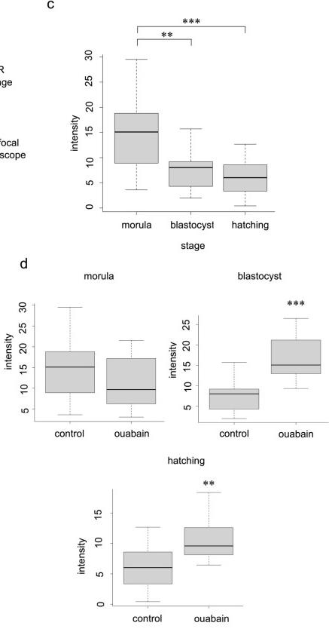
Fujishima A, Takahashi K, Goto M, Hirakawa T, Iwasawa T, et al. (2021) Live. PLOS ONE 16(1): e0246337. https://doi.org/10.1371/journal.pone.0246337
Visualization of electrolytes during mouse
embryonic development using electrolyte indicators
used CoroNa Green AM and ION Potassium Green-2 AM to directly visualize [Na⁺]i and [K⁺]i, respectively, at each embryonic developmental stage in mouse embryos.
results revealed dynamic changes in intracellular electrolyte concentrations with reduction in [Na⁺]i and increase in [K⁺]i during blastocoel formation.
The degree of change in intensity in response to ouabain, an inhibitor of Na⁺/K⁺ ATPase, was considered to reflect the degree of Na⁺/K⁺ ATPase activity at each developmental stage.
Fig 1. Live visualization of Na⁺ and intensity analysis using CoroNa Green AM.

Slide 30
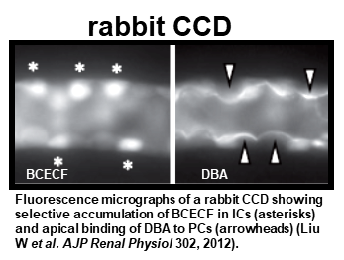
Assay for cell pH (pHi) and basolateral
Na⁺/H⁺ exchange in nonperfused tubules using BCECF
after equilibration at 37ºC, tubule/cells is/are loaded with 20 µM acetoxymethyl ester BCECF added to the bath x 30 min and rinsed x 10 min with Na Ringer’s solution
digital ratio fluorometry (490 nm/440 nm) performed of individually identified cells.
intracellular calibration with nigericin (20 µM) performed to convert fluorescence intensity ratios (490 nm/440 nm) into pHi values.
The detailed protocol is available in:
Liu et al. Luminal flow modulates H⁺-ATPase activity in the cortical collecting duct (CCD). Am. J. Physiol. Renal 2012. https://doi.org/10.1152/ajprenal.00179.2011

Slide 31
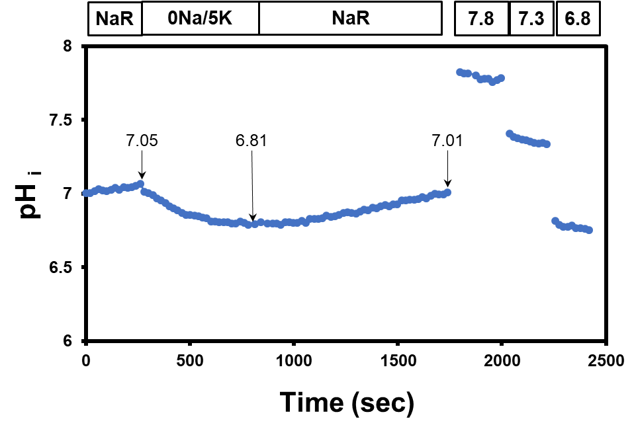
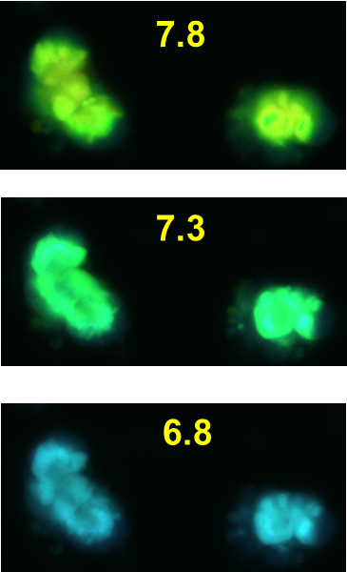
Assay for basolateral Na⁺/H⁺ exchange in nonperfused organoid tubules
time
time (s)
Changes in intracellular pH (pH_{i}) measured following removal of Na⁺ from the bath solution.
Reduction in pHi is consistent with active basolateral Na⁺/H⁺ exchange in non-perfused BCECF-loaded tubule from this 22 d.o. organoid.

Slide 32
Assay for intracellular Ca²⁺ concentration ([Ca²⁺]_{i}) in nonperfused tubules using BCECF
after 45 min equilibration at 37ºC, tubule/cells is/are loaded with 20 µM acetoxymethyl ester fura-2 (Calbiochem, catalog 344906) added to the bath x 30 min and rinsed x 10 min.
digital ratio fluorometry (340 nm/380 nm) performed of individually identified cells.
intracellular calibration with EGTA-AM and ionomycin.
The detailed protocol is available in:
Carrisoza-Gaytan et al. Intercalated cell BKα subunit is required for flow-induced K⁺ secretion
JCI Insight. 2020;5(8):e130553. https://doi.org/10.1172/jci.insight.130553.

Slide 33
Basolateral Yoda1, a Piezo1 agonist, increases [Ca²⁺]_{i}
in non-perfused organoids (H9♀) during “maturation”
Basolateral Yoda1 (20 µM) increases [Ca²⁺]_{i} consistent with the presence of functional basolateral Piezo1 channels
Resting and peak [Ca²⁺]_{i} appears to increase with advancing age.
H9 ♀
67 d.o. (n=6)
[Ca²⁺]_{i} (nM)
43 d.o. (n=6)
31 d.o. (n=8)
24 d.o. (n=7)
20 µM Yoda 1
time (s)
n= total # cells studied in 2 tubules at each age, with 1 tubule studied per organoid

Slide 34
Advanced tubular functional assays (will require collaboration within the RBK community)

Slide 35
Micropuncture of single nephrons for analysis of single nephron function
Introduced by A. Newton Richards and Joseph Wearn in the 1920s.

Slide 36
Micropuncture of single nephrons: development
Limitation of method in studying the developing kidney: the absence of functioning nephrons in the relatively undifferentiated superficial nephrogenic zone in most animal species.
Exception - guinea pig, which is born, like the human, with functional superficial nephrons.
Functional and morphologic maturation of the superficial nephrons
Superficial nephron GFR increased from ~1 to 20 nl/min between 2 and 38 d.
The proportionality between glomerular filtration and proximal reabsorption of fluid (i.e., glomerulo-tubular balance) is maintained throughout development.
Spitzer A and Brandis M. Functional and morphologic maturation of the superficial nephrons. Relationship to total kidney function. JCI 53:279-87, 1974

Slide 37
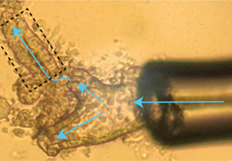
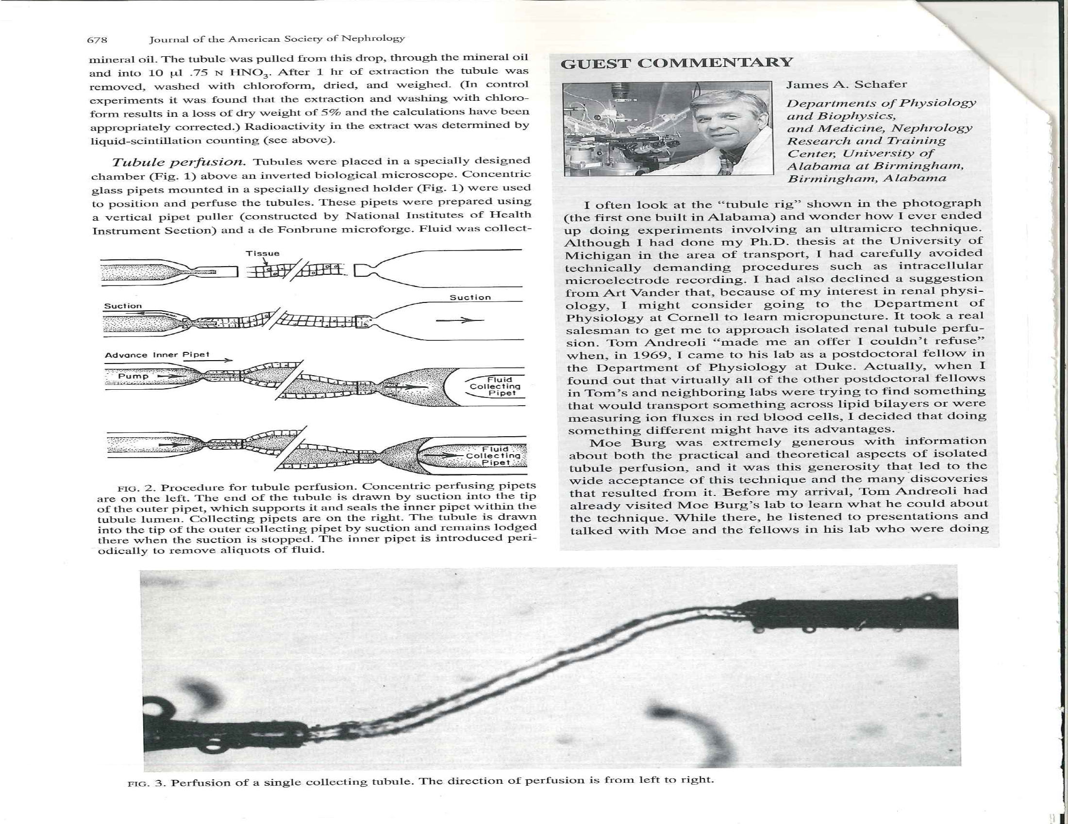
In vitro microperfusion of isolated tubules
Developed by Maurice Burg at the NIH (Burg M et al. Preparation and study of fragments of single rabbit nephrons. AJP 210:1293-1298, 1966).
Provides a means of examining the transport characteristics of discrete tubular segments of known identity and location, including those not accessible to micropuncture (e.g, TALH and collecting duct), under standardized conditions [throughout development], in the absence of potentially confounding luminal (e.g, filtered load) and peritubular (e.g, circulating hormones) factors.
Cannulated 36 d.o. static organoid tubule (diameter = 40 µm) held in a perfusion pipette. Arrows indicate direction of luminal perfusion flow.
C

Slide 38
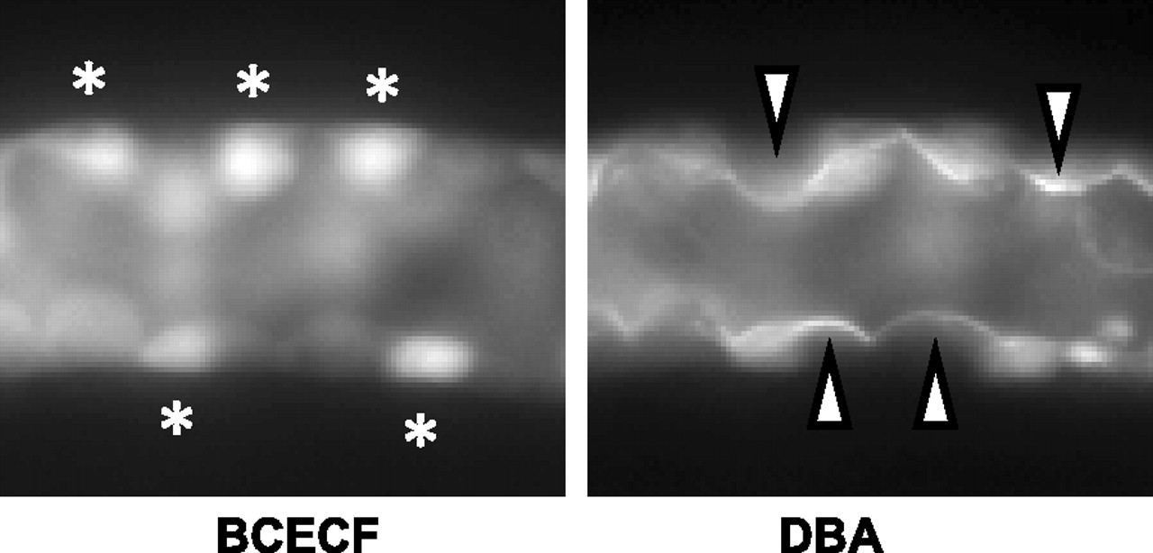

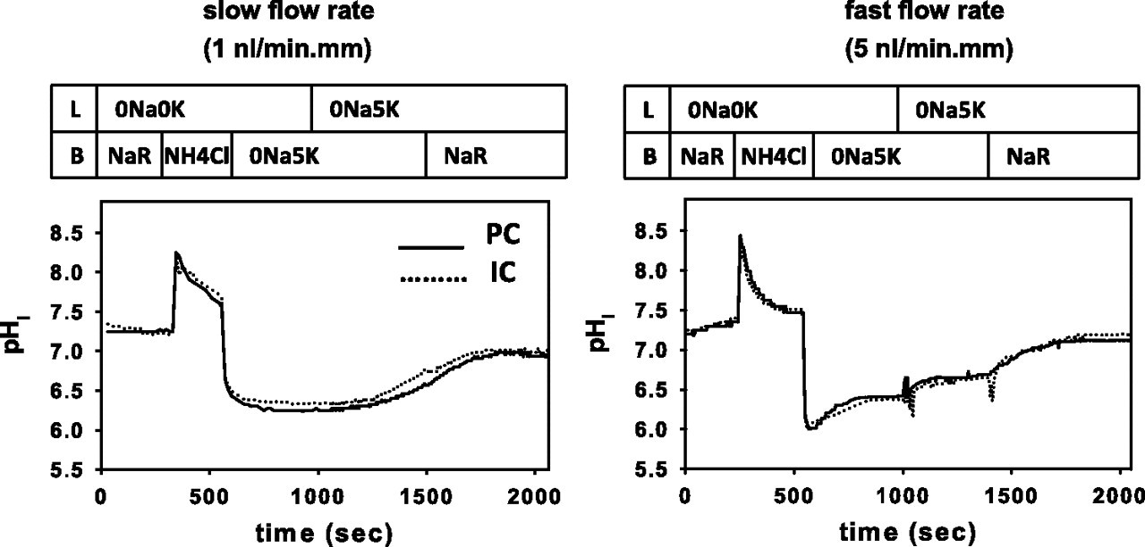
Assays for H⁺ transport: Na⁺/H⁺ exchange and H⁺-ATPase activity in tubules microperfused in vitro
Changes pH_{i} measured following an acute NH₄Cl-induced acid load in BCECF-loaded tubules
lumen
CCD
intercalated cell (type A)
bath
H⁺
H⁺
Na⁺
K⁺
H⁺
Liu et al, 2012, 302(1):F205-15
The detailed protocol is available in:
Liu et al. Luminal flow modulates H⁺-ATPase activity in the cortical collecting duct (CCD). Am. J. Physiol. Renal 2012. https://doi.org/10.1152/ajprenal.00179.2011
Na⁺/H⁺ Exchanger
H⁺/K⁺-ATPase
H⁺-ATPase

Slide 39
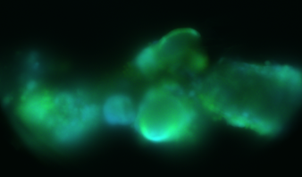
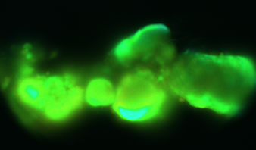
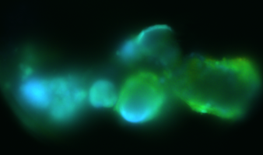
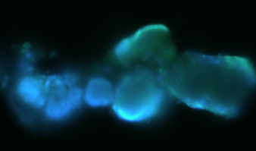
Na⁺/H⁺ exchange and H⁺-ATPase activity in
organoid tubules microperfused in vitro
22 d.o.
31 d.o.
L | NaR | 0Na/0K | 0Na/5K | NaR
L | NaR | 0Na/0K | 0Na/5K | NaR
B | NaR | NH₄ | 0Na/5K | NaR
B | NaR | NH₄ | 0Na/5K | NaR
7.33 ± 0.02
6.86 ± 0.02
6.78 ± 0.02
7.1 ± 0.03
6.51 ± 0.02
6.39 ± 0.02
luminal
Na⁺/H⁺ exchanger
basolateral
Na⁺/H⁺ exchanger
Preliminary data suggest that “young” BCECF-loaded tubules isolated from superfused organoids and microperfused in vitro:
exhibit apical and basolateral Na⁺/H⁺ exchange activity, consistent with a proximal tubule phenotype
do not demonstrate H⁺-ATPase or H⁺-K⁺-ATPase

Slide 40
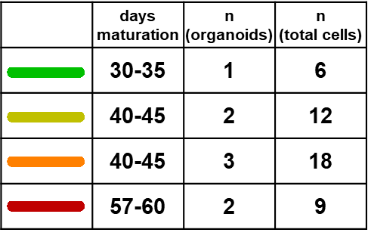
Microperfusion of isolated tubules in vitro:
maturation of the luminal flow/stretch-induced
[Ca²⁺]_{i} response in organoid (H9♀) tubules
[Ca²⁺]_{i} (nM)
flow on
time (s)

Slide 41
Microperfusion of isolated tubules in vitro:
development of HCO₃ absorption and
Na-K-ATPase activity and in rabbit PT
The rate of HCO₃ absorption in PTs from 1-wk-old rabbit was 1/3 that measured in the adult and did not change significantly until weaning (4 wks).
By 6 wks of age, the rate of HCO₃ absorption was comparable to that in the adult.
In the adult PT, ~2/3 of HCO₃ absorption (H⁺ secretion) is mediated by apical Na⁺/H⁺ exchange, requiring a low [Na⁺]_{i} sustained by the basolateral Na-K-ATPase.
The rapid increase in the rate of HCO₃ transport follows by ~1 wk the maturational increase in Na-K-ATPase activity.
Schwartz GJ and AP Evan. Development of solute transport in rabbit proximal tubule.
I. HCO3 and glucose absorption. AJP 245:F382-F390,1983
III. Na-K-ATPase activity. AJP 246:F845-52, 1984

Slide 42
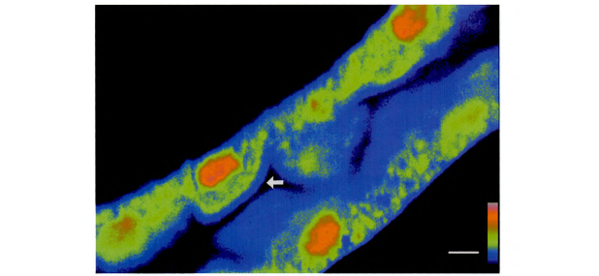
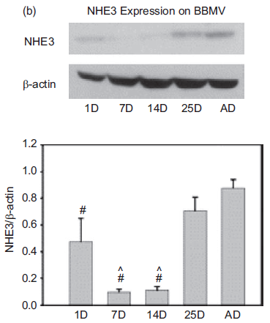
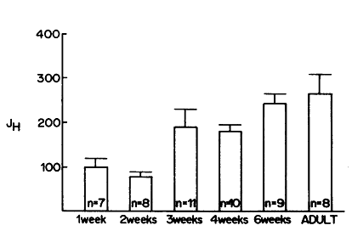
Microperfusion of isolated tubules in vitro:
ontogeny of apical NHE exchanger activity in PT
+ functional fluorescence molecular probes
Proton flux (J_{H} in pmol/mm.min) in response to luminal Na⁺ removal in BCECF-loaded rabbit PCTs: the initial rate of change in cell pHi, reflecting Na⁺/H⁺ exchange, was constant for the first 2 wks of life but by wk 3, the rate almost doubled.
NHE3 protein abundance in in renal brush border membrane vesicles (BBMV) relative to β-actin. Protein abundance, assessed by immunoblot analysis, increased dramatically at 14 d.
Baum M. Neonatal rabbit juxtamedullary proximal convoluted tubule acidification. JCI 85:499-506, 1990
Becker AM, Zhang J, Goyal S et al. Ontogeny of NHE8 in the rat proximal tubule. AJP Renal Physiol 293: F255-61, 2007

Slide 43
Microperfusion of isolated tubules in vitro:
ontogeny of cation transport in the rabbit CCD
Postnatal maturation of K⁺ transport
in rabbit CCD
>6 wk
2 wk
4 wk
4 wk
weaning
2 wk
nephronogenesis just complete
>6 wk
Net Na⁺ absorption in the newborn (2-wk-old) rabbit CCD is equivalent to that measured in the adult over a wide range of tubular fluid flow rates, whereas net K⁺ secretion, absent at birth, is first detected at 4 wks of age.
Satlin LM. Postnatal maturation of potassium transport in rabbit cortical collecting duct.
AJP 266:F57-65, 1994

Slide 44
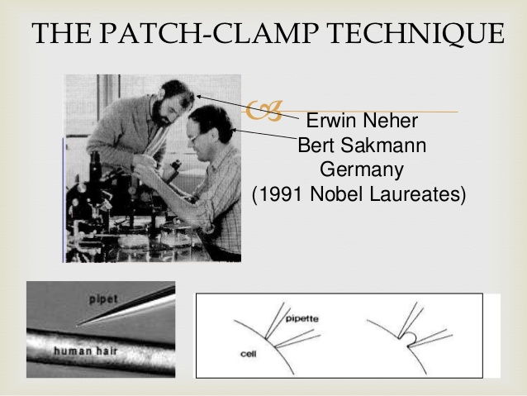
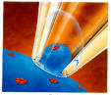
Patch clamp analysis for functional
investigation of single protein molecules
Developed in the 1970s by Erwin Neher and Bert Sakmann B (Single-channel currents recorded from membrane of denervated frog muscle fibres. Nature 260:799–802, 1976).
Allows the behavior/function of a single protein molecule to be observed in its native environment in the cell, exploiting the ability of an individual channel to carry net flows of 10⁶ ions/s or more, giving rise to picoampere currents (readily detected using low-noise electronic recording techniques).
Notes:
A fluid-filled micropipette, considerably less sharp than one that would be used for intracellular measurements, is lowered gently onto the surface of a cell so that contact is made with the cell membrane but the membrane is not punctured. If a good seal (i.e., one with high electrical resistance) is formed between the glass and the membrane, ions moving through the membrane covered by the pipette (the patch) will give rise to an electrical signal that is transmitted through the pipette solution to an amplifier. The inside of the pipette is usually kept at a constant potential with a voltage-clamp circuit so that ion flows through channels in the patch are detected by the circuit as currents. What is actually measured are changes in current caused by abrupt openings or closings of channels in the patch. The switching on and off of channels in other parts of the cell1 membrane not covered by the pipette is normally not detected.

Slide 45
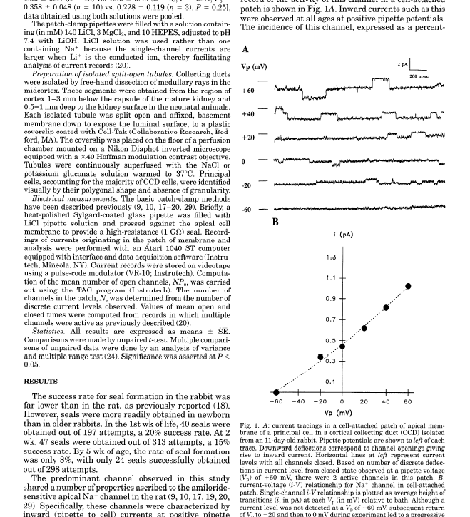
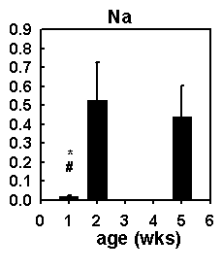

Patch clamp analysis of split-open tubules:
ontogeny of cation channel function in the CCD
ENaC current tracings in a cell-attached patch of apical membrane of a principal cell in a CCD from a 11-d-old rabbit. Pipette potentials are shown to left of each trace. Downward deflections correspond to channel openings.
Developmental changes in Na⁺ (ENaC) and K⁺ (ROMK) channel activity (N, number of channels x Po, open probability) in apical membrane of rabbit principal cells.
Huber SM and Horster MF. Ontogeny of apical membrane ion conductances and channel expression in cortical collecting duct cells. AJP 271:F698-708, 1996;
Satlin LM and Palmer LG. Apical Na⁺ conductance in maturing rabbit principal cell. AJP 270:F391-7, 1996; Apical K⁺ conductance in maturing rabbit principal cell. AJP 272:F397-404, 1997.

Slide 46
BK channels are expressed in human kidney organoids
Kleyman, Pittsburgh

Slide 47
ROMK channels are expressed in human kidney organoids
Kleyman, Pittsburgh

Slide 48
ENaCs are expressed in human kidney organoids
Kleyman, Pittsburgh

Slide 49
Measurement of TEER and TEPD TEER = Trans-Epithelial Electrical Resistance TEPD = Trans-Epithelial Potential Difference

Slide 50



Aldosterone increases amiloride-sensitive current
in human stem cell derived collecting duct cells
Methods:
Confluent cells are seeded and grown in growth medium on Transwells for 5-7 d.
Transepithelial electrical resistance (ohm/cm2) and voltage were measured under sterile conditions by using a EVOM3 (epithelial volt/ohm meters 3) with STX2-PLUS-Modified Electrode-Prototype Type: Silver Chloride Coated.
Bonventre and Lee, Harvard

Slide 51





Integrated Kidney Epithelial MAP
TEER
TEPD=V_{b}-V_{a}
Real-time Non-invasive Monitoring of
Trans-Epithelial Electrical Resistance (TEER) Trans-Epithelial Potential Difference (TEPD)
Lumen
R_{med}
C_{m}
E_{Na}
E_{K}
V_{a}
Multichannel
System
R_{TEER}
V
C_{m}
E_{K}
E_{Na}
I_{Na}
V_{b}
I_{K}
Blood
C_{el}
24-plex
Multi-well
Design
Bonventre and Lee, Harvard

Slide 52



Design of Functional Single Unit
Media reservoirs
Lower
channel inlet
Upper
channel inlet
z
x
Upper
channel outlet
y
Lower
channel outlet
Basolateral
electrodes
Basolateral
electrodes
Luminal electrodes
Luminal electrodes
Physiological Shear Stress
Design for electrophysiological characterization in continuous flow
High-sensitive long-term electrical readout
Unit design for multiplex array
Bonventre and Lee, Harvard

Slide 53







Human Collecting Duct MAP
Integrated MAP
Ureteric bud organoids
Dynamic 3D culture
Automation
In-situ measurement
Multiplexed real-time, non-invasive, systems electrophysiology
Impedance
Spectroscopy
CD segment
Single-cell dissociation
Culture in transwell
Human CD MAP with Integrated TEER and TEPD Sensors
Bonventre group
Lee group

Slide 54
Other assays

Slide 55

cAMP induces organoid swelling
Forskolin increases cAMP, proposed to be a central target in PKD
100 µm
Cruz et al., Nat. Materials., 2017;
see also Low et al., Cell Stem Cell, 2019; Kuraoka et al,, JASN, 2020; Howden et al., Cell Stem Cell, 2021

Slide 56
Toxicity assays
Takasato et al., 2015, Nature
Freedman et al., 2015, Nature Communications
Czerniecki et al., 2018, Cell Stem Cell
Digby et al., 2020, AJP Renal

Slide 57
Nephrotoxic assay using kidney organoids
When kidneys mature, nephron epithelial cells respond to toxicants in a segment-specific manner via drug transporters. As an example, cisplatin and gentamicin were shown to induce proximal tubular injury as evidenced by KIM-1 and gH2AX expression in LTL+ proximal tubular cells.
At an optimal concentration, the injury responses should be observed in a segment-specific manner, and higher concentrations of toxins will result in global injury to varied cell types. If segment-specific injury is not observed with the following protocol, it suggests immaturity of tubular cells in drug transporter expression.
The detailed protocols are available in the following publications.
Morizane et al., Nature Biotechnology, 2015
Morizane et al., Nature Protocols, 2017

Slide 58
Organoids selectively absorb dextran
Pipette into media (pulse)
Exchange media (chase)
10 kDa Rhodamine dextran (RD) accumulates
lucifer yellow (LY) is not absorbed
Uptake is actin dependent
(blocked by latrunculin B)
100 µm
Freedman et al., Nat. Comms., 2015; see also Takasato et al., Nature, 2015, and Low et al., Cell Stem Cell, 2019

Slide 59

Membrane potential fluorescent indicators
The slow-response potential-sensitive probe, DiBAC₄(3) enters depolarized cells where it binds to intracellular proteins or membrane and exhibits enhanced fluorescence and a red spectral shift. Increased depolarization results in additional influx of the anionic dye and an increase in fluorescence. Conversely, hyperpolarization is indicated by a decrease in fluorescence. This bis-oxonal has an excitation maximum of 490 nm and emission maximum of 516 nm. DiBAC dyes are excluded from mitochondria because of their overall negative charge, making them superior to carbocyanines for measuring plasma membrane potentials.
https://www.thermofisher.com/us/en/home/life-science/cell-analysis/cell-viability-and-regulation/ion-indicators/membrane-potential-indicators.html#mem

Slide 60
Example: Sun, J et al: Fluid shear stress induces calcium transients in osteoblasts through depolarization of osteoblastic membrane. J. Biomechanics 47:3903-3908, 2014 https://doi.org/10.1016/j.jbiomech.2014.10.003
Membrane potential fluorescent indicators
Methods to measure membrane potential changes:
Load cells x 15-30 min with 5 μM DiBAC4(3) at room temperature
To avoid dilution of DiBAC4(3) during the experiments, all plastics except the cell plates should be pre-rinsed with NTS containing 10μM DiBAC4(3) and the fluid medium contains 5μM DiBAC4(3).
Do not remove the dye solution. Measure fluorescence signal at 480 nm excitation and emission using a 520 nm interference filter.
Record images every 1 s.
See also:
Adams D.S. et al. (2007) H⁺ pump-dependent changes in membrane voltage
are an early mechanism necessary and sufficient to induce Xenopus tail regeneration.
Development 134:1323–1335.

Slide 61
Are there new in vivo tools or iPS cell line reporters which need to be generated?
genetically encoded fluorescent sensors
Ca²⁺ (GCAMPF6)
pH
Membrane potential
Cl⁻
fluorescent nanoparticles for measurement of ion concentrations
Additional references:
Ryuji Morizane et al: Bioengineered kidney models: methods and functional assessments

